Slide 1
BYU-SCUT EXCHANGING PROGRAME
Presented by: (in alphabet order)
Ada
Lucifer
Luke
Michelle
Ronnie*

Slide 2
CONTENTS
Introduction
Exchange Programs SCUT provides
School of Architecture exchanging program
School of Materials exchanging program
SCUT environment
Exchange Program SCUT suggests
School of Management exchanging program
Conclusion

Slide 3
CONTENTS
Introduction
Exchange Programs SCUT provides
School of Architecture exchanging program
School of Materials exchanging program
SCUT environment
Exchange Program SCUT suggests
School of Management exchanging program
Conclusion

Slide 4

INTRODUCTION
25,000 undergraduates and 18,000 postgraduates
Dedicated to educating engineers for 60 years
Ranked 138 worldwide by Leiden in 2013
China’s first-level university
Industry technology, Architecture, Materials Science…

Slide 5

INTRODUCTION
The largest religious university and one of the largest private universities in U.S.
28,000 undergraduates and 2,000 full-time postgraduates
Ranked 62nd in the U.S. by U.S.News in 2013
Marriott School of Management received a No.5 ranking by Business Week in 2009
MBA program ranked 92nd among business schools worldwide.

Slide 6
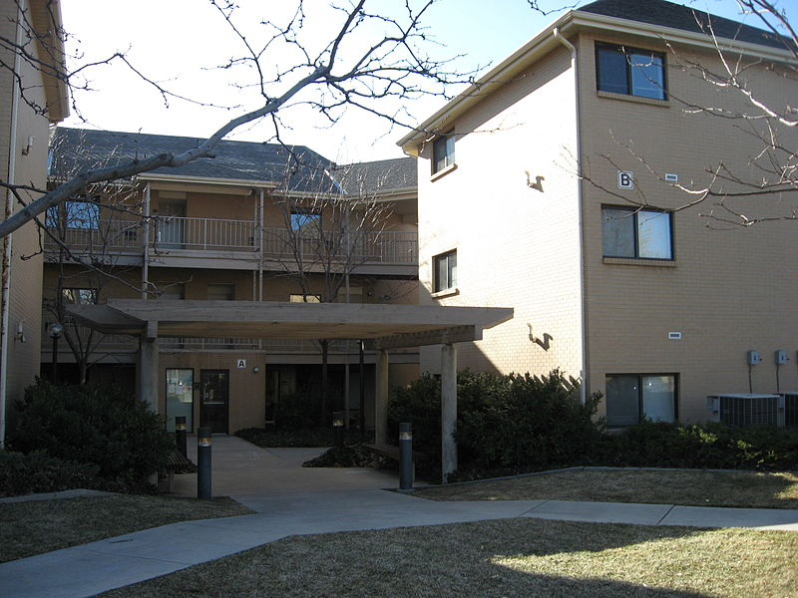
FOUNDATION OF COOPERATION?
Both are worldwide famous universities
For the BYU:
Strong engineering background in SCUT
A longer exchanging program in China
For the SCUT:
A multi-language environment
China needs more specialists
International Students Dormitory

Slide 7
CONTENTS
Introduction
Exchange Programs SCUT provides
School of Architecture exchanging program
School of Materials exchanging program
SCUT environment
Exchange Program SCUT suggests
School of Management exchanging program
Conclusion

Slide 8
SCHOOL OF ARCHITECTURE
About Majors
Architecture
Urban planning
Landscape design
About Study Plan
General education course
Professional development courses

Slide 9
FACULTY & FACILITIES
Teaching and Administrative Staff
21 professors & 29 associate professors
63 supervisors of postgraduate
17 Supervisors of PhD Candidates
2 academician of the Chinese Academy of Engineering
1 Professor of Cheung Kong Scholars
Frequent Exchanges with Many Famous Universities
Perfect Facilities
Architectural Design and Research Institute of SCUT
National key Laboratory of Subtropical Building Science
Architectural History and Culture Research Center of SCUT
Building Energy Research Center of SCUT

Slide 10
ABOUT STUDENTS
Top 1% students in the field of architecture of China
Nearly 30% have been admitted by top 50 Colleges worldwide in 2014
Over 90% have their ideal job when graduate

Slide 11
Contents
Introduction
Exchange Programs SCUT provides
School of Architecture exchanging program
School of Materials exchanging program
SCUT environment
Exchange Program SCUT suggests
School of Management exchanging program
Conclusion

Slide 12
COLLEGE OF MATERIALS SCIENCE AND ENGINEERING
Historical college
Abundant funding
Two majors for exchange project
Materials science
Material processing project

Slide 13
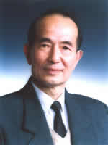
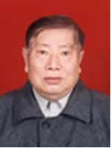
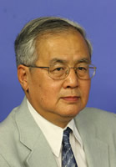
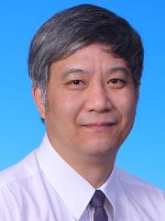
WE HAVE THE FIRST-CLASS FACULTY
High level teachers
270 people in-service
71 doctoral supervisors
151 master supervisors
9 academicians of CAS

Slide 14
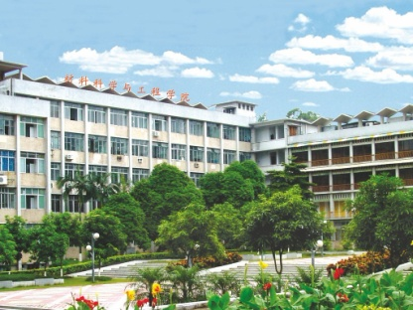
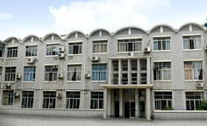

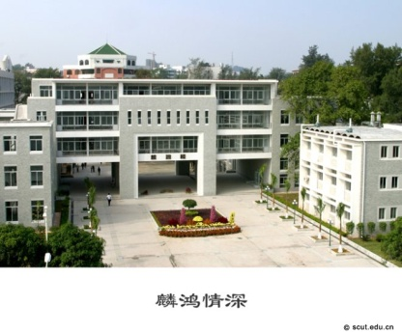
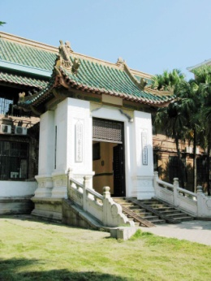
MODERN TEACHING FACILITIES
College of materials now consists of 5 faculties, 6 Research Institute, 1 national key laboratory, 1 national engineering research centers and 5 provincial and ministerial key laboratories, 4 provincial engineering research centers, and one State-level experimental teaching demonstration Center.

Slide 15
Contents
Introduction
Exchange Programs SCUT provides
School of Architecture exchanging program
School of Materials exchanging program
SCUT environment
Exchange Program SCUT suggests
School of Management exchanging program
Conclusion

Slide 16
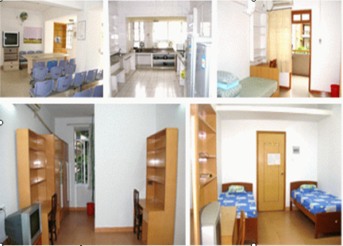
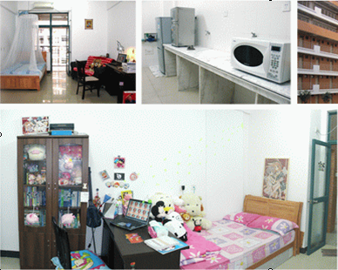
ACCOMMODATION
International Student Dorm
North Campus and South Campus -Building C15

Slide 17
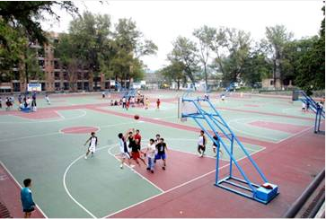
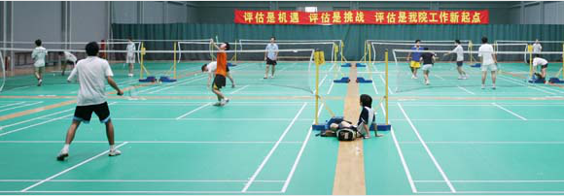

SPORTS & RECREATION
Basketball, Football, Tennis, Badminton, Skating rink , Swimming pool and so on.

Slide 18



GUANGZHOU ATTRACTIONS
White Cloud Mountain
Canton Tower
Yue Cuisine

Slide 19
Contents
Introduction
Exchange Programs SCUT provides
School of Architecture exchanging program
School of Materials exchanging program
SCUT environment
Exchange Program SCUT suggests
School of Management exchanging program
Conclusion

Slide 20



WHAT DO WE EXPECT FROM BYU
——School & majors that we are interested in
Business (Marriott School of Management)
School of Accountancy
1st, clubs, Outstanding Educator
School of Finance
21st, clubs
Notes:
We are interested in the Marriott School of Management which has nationally recognized programs in accounting, business management, public management, information systems, and entrepreneurship.
And we want to exchange of students to School of Accountancy an School of Finance.
As we all know, SOA which is school of accountancy ranks 1st and SOF ranks 21st according to Wall Street Journal 2010. There are 2 excellent clubs in SOA—BAP and WSOA.
1.Alpha Psi (BAP)
Is a fraternity offers an opportunity for accounting students to attend weekly lectures by outstanding speakers on subjects which are relevant to today’s accountant and business leader.
2.Women in the SOA (WSOA)
Provides women in the SOA with career options tailored to their individual needs.
Besides, there is a well known professor, Robert Gardner who was recently honored with the prestigious 2013 Outstanding Educator award from the Utah Association of Certified Public Accountants.
“Bob has an incredible knowledge of the tax code and a penchant for teaching students how to research and think critically,” says Jeff Wilks, School of Accountancy director. He received the Marriott School’s Outstanding Faculty award in 2001 and served as the director of the School of Accountancy from 1996–2002. Outside of academia, Gardner received the 2006 Outstanding Service award from the American Taxation Association and served as a member of the American Accounting Association Council and the National Tax Academic Advisory Boards for Ernst & Young and Deloitte & Touche.

Slide 21
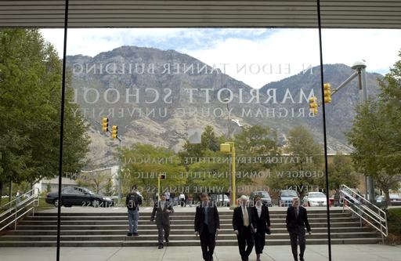

WHAT DO WE EXPECT FROM BYU
—— Classes that we are interested in
Financial management
Strategic management
Money , banking, and business
Analyses for investment bankers
Economics of strategy
Notes:
Next let’s talk about the courses that we are interested in.
FINANCIAL MANAGEMENT is a classic and fundamental course in every accounting department. As it provides the core methodologies in accounting field, whether a student fully masters this course determine his or her competency in this field. So we SCUT SOA would like to suggest us students to select your Financial Management and benefit from your way of teaching.
Analyses for investment bankers is also an appealing course. Needless to say, US financial market is the most
mature one around the globe…

Slide 22
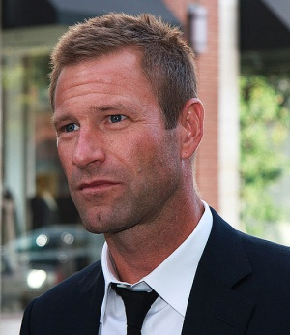
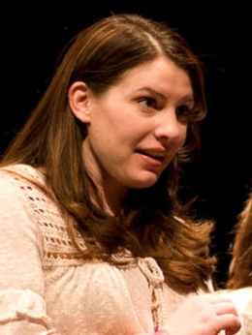


WHAT DO WE EXPECT FROM BYU
Famous alumni
Stephanie Meyer - author of Twilight Saga
Aaron Echkhark - US Actor
Campus life
Food
Rules
Sports(cross country)
Museum
Notes:
Food:Chef de Cuisine:Adam Jones
Rules:
BYU students are required to follow an honor code, which mandates behavior in line with LDS teachings (e.g., academic honesty, adherence to dress and grooming standards, and abstinence from extramarital sex and from the consumption of drugs and alcohol).^{[12]} Many students (78% of men, 10% of women) take a two-year hiatus from their studies at some point to serve as Mormon missionaries.^{[13][}
Sports:
Baseball, Boys Basketball, Cheer and Dance, Cubs Camps, Diving, Fathers and Sons, Football, Girls Basketball, Golf, Gymnastics, Lacrosse, Rugby, Soccer, Softball, Speed and Power, Swimming, Tennis, Track and Field, Volleyball
Say something about Cross Country
MUSEUM:
One of the largest and best-attended art museums in the Mountain West.
The Museum of Art was designed by Los Angeles architect James Langenheim. Former directors of lighting and design at the Metropolitan Museum of Art, LeMar Terry and Stuart Silver, assisted in determining the sophisticated lighting requirements and the best functional use of space.

Slide 23
THANK YOU!

